Slide 1

Extracting Ontological Relations of Korean Numeral Classifiers from Semi-structured Resources Using NLP techniques
Youngim Jung, Soonhee Hwang, Aesun Yoon, Hyuk-Chul Kwon
{acorn, soonheehwang, asyoon, hckwon}@pusan.ac.kr
Korean Language Processing Lab
Pusan National University
Notes:
Good afternoon ladies and gentlemen,
I am Youngim Jung from Korean Language Processing Lab at Pusan National University. My talk is about “ExtrAction of onTOlogical relations from semi-structured resources using NLP techniques for building Korean Numeral classifier Ontology.

Slide 2
Table of Contents
Introduction
  1.1 Motivation
  1.2 Aims of Study
Related Work
Semantic Analysis of Korean Classifiers
Building Classifier Ontology
Conclusion and Further Work
Notes:
My presentation will be proceeded in the following order.

Slide 3
1.1 Motivation
Numeral Classifiers (NC)
Quantifying a noun or a class of nouns
Categorizing a noun along their specific semantic properties
Mandatory morphological devices for referring to a specific number of nouns in Asian languages
Refined numeral classifier systems are developed in Asian languages

Slide 4
1.1 Motivation
Numeral Classifiers as linguistic devices to quantification
Quantity as key information in daily life
Quantity confirmation is required in Home-shopping and e-shopping
  e.g.) shinbal 2 GAE “two shoes” or “two pairs of shoes” ???
  shoe two NC for counting things
Quantity identification is required
  e.g.) jusig 2 JU vs. jusig 2 GAE
  stock two NC for counting stocks stock two NC for counting things
  “Do they express the same quantity of stocks???”
Machines should identify “NC” to understand the quantification of things

Slide 5
1.1 Aims of Study
To Analyze the semantic characteristics of NC and the relations with its co-occurring nouns
To Extract ontological relations from semi-structured or unstructured language resources using NLP techniques
To Build Korean Numeral Classifier Ontology

Slide 6
Table of Contents
Introduction
Related Work
  1.1 Method of Method of Ontology Construction
  1.2 Building Classifier Database/Ontology
Semantic Analysis of Korean Classifiers
Building Classifier Ontology
Conclusion and Further Work

Slide 7
2.1 Method of Ontology Construction
Initial Construction of Ontology
Many suggestions for constructing ontologies in general (Gruber, 1993; Gomez-Perez et al, 2003)
Mainly manual tasks by experts should be devoted to construct an ontology
Very expensive (time and labor cost much)
Merging and modifying Established Ontologies
Reusing related ontologies by merging and modifying them
Few established ontologies corresponding to one’s purpose
Sometimes modification costs more
Translating Ontologies written in foreign languages
Most concepts are universal
Many concepts are dependent to each language (semantic gap)
Numeral classifiers are language-dependent

Slide 8
2.2 Building Classifier Database/Ontology
Japanese Numeral Classifier Ontology (Bond et al, 1997;2000;2003)
Using categories in noun ontology for generating the relationship between limited numbers of classifiers and nouns in texts
No specific method for resolving ambiguities derived from processing natural language texts
Chinese Numeral Classifier Ontology (Huang et al, 2003)
Analysis on the four categories of Chinese numeral classifiers
Korean Numeral Classifier Database (Nam, 2006)
Building lists of classifiers under five main categories
No suggestion for the (semi) automatic method for building classifier database or ontology
Lack of semantic relations between noun and numeral classifiers

Slide 9
Table of Contents
Introduction
Related Work
Semantic Analysis of Korean Classifiers
  3.1 Knowledge Resources
  3.2 Semantic Relations between Classifiers and Nouns
  3.3 Categorization of Korean Classifiers
Building Classifier Ontology
Conclusion and Further Work

Slide 10
3.1 Knowledge Resources
Table 1. Knowledge Resources for Building Korean Numeral Classifier Ontology
Resources | Characteristics | Size
Standard Korean Dictionary | sense distinguished definitions | 500,000 entries
List of high-frequency Korean classifiers | frequent Korean numeral classifiers extracted from large corpus in previous study | 676 classifiers
Corpus | newspaper articles, middle school text books, scientific papers, literary texts, and law documents | 7,778,848 words, (450,000 occurrences of classifiers)
WordNet Noun 2.0 | general-purpose lexical database | 79,689 synsets
KorLex Noun 1.5 | Korean wordnet based on WordNet 2.0 | 58,656 synsets

Slide 11
3.2 Semantic Relations between Classifiers and Nouns
Selection of the classifier based on the properties of the co-occurring nouns
  E.g.) chaeg 2-GWON
  book two-NC for counting bound printed matters
  ‘two books’
  A classifier, GWON is selected to indicate the quantity of books
  The classifier GWON must appear only with all of the bound printed matters
  e.g. books, magazines, theses
For the appropriate selection of the classifier, each classifier shows its specific semantic restrictions on the objects being counted

Slide 12
3.3 Categorization of Korean Classifiers
Four major types of classifiers in Korean
Mensural-CL : measuring the amount of some entity
  Units of measures such as time, space, metric unit or monetary unit
Sortal-CL : classifying the kinds of quantified noun-referents
  This class classify the kind of quantified noun phrase, and can be divided into two sub-classes by [+/-living thing].
Event-CL : quantifying abstract events
  This class can be divided into at least two kinds by its most salient features, [+/-time], e.g., [+event] and [+attribute]
Generic-CL : restricting quantified nouns to generic kinds
  This class can co-occur with generic kinds of things, limiting to only [-living thing]
  ➔ The attributes [group] and [part] added to each classifier category
  The [+group] further classified into [+/-fixed number], and [+fixed number] into [+/-pair]

Slide 13
Table of Contents
Introduction
Related Work
Semantic Analysis of Korean Classifiers
Building Classifier Ontology
  4.1 NLP for Extraction of Ontological Relations
  4.2 Generation of Hierarchies of Classifiers
  4.3 Generation of Relations between Nouns and Classifiers
  4.4 Results and Discussion
Conclusion and Further Work

Slide 14
4.1 NLP for Extraction of Ontological Relations
Available Knowledge/language Resources
Structured: WordNet 2.0, KorLex 1.5
Semi-structured: Standard Korean Dictionary, List of high frequency Korean classifiers
Unstructured: Corpus
Classifiers registered in high frequency list and Standard Korean Dictionary
  1,138 numeral classifiers are selected
Natural Language Processing (NLP) Techniques
In Korean, content word and function morphemes come in one word
  A variety of inflected variants in texts
  A number of polysemies and homonyms
NLP is the prerequisite to
  Extracting ontological relations from semi-structured dictionaries or raw corpus.

Slide 15
4.1 NLP for Extraction of Ontological Relations
Collection of lexical information from structured resources
POS, origin, polysemy (or sense distinction), domain, and definition of Korean classifiers are collected from dictionary
“units of measure” included in KorLex Noun 1.5
  Semantic relation such as synonyms, hypernyms/hoponyms, holonyms/meronyms, antonymys are obtained without additional processing

Slide 16
4.1 NLP for Extraction of Ontological Relations
Shallow parsing of semi-structured definitions
semantic relations were extracted from the dictionary definitions
Classifier | Transcribed sentences in definition | Translated sentences in definition
DOE | Bupi-ui dan-wi; | (It is a) unit of volume
 | Gogsig, galu, aegche-ui bupileul jael ttae ssunda; | (It is) used for measuring the volume of grain, powder, or liquid
 | Han doe-neun han mal-ui 10bun-ui 1e haedanghanda; yag 1.8 liteo | One DOE is one tenth of one MAL; about 1.8 liter
IsHypernymOf
MeasureVolumeOf
ISHolonymOf

Slide 17
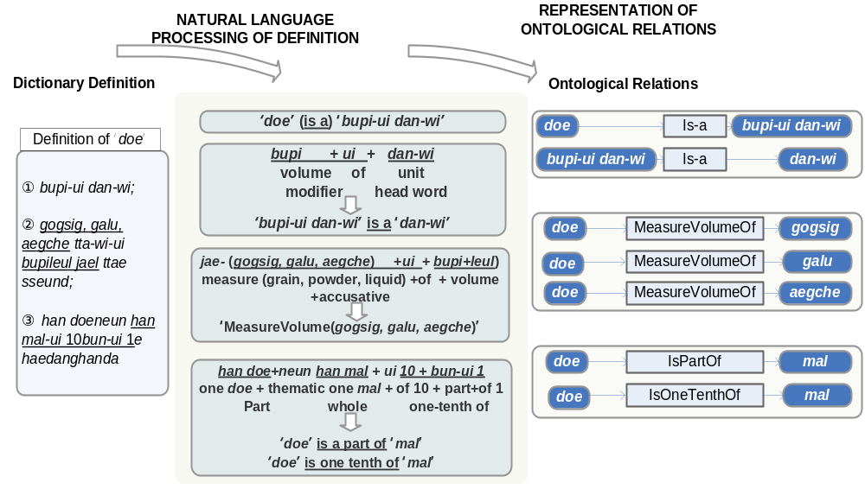
4.1 NLP for Extraction of Ontological Relations
Figure 1. Shallow Parsing of Dictionary Definition

Slide 18
4.1 NLP for Extraction of Ontological Relations
POS-tagging and parsing of unstructured texts
Many co-occurring nouns can be collected from unstructured texts in corpus
Syntactic Patterns of Nouns and Numeral classifiers
  Pre-NP postition Post-NP position
  a. 2-jang-ui jongi b. jongi 2-jang
  2-NC-GEN paper paper 2-NC
  2 sheets of paper paper 2 sheets
Pre-numerals, post-numerals, post-classifiers and modifiers can be added
Their combined pattern varies in real texts
POS tagging and parsing of sentences are processed

Slide 19
4.1 NLP for Extraction of Ontological Relations
Word Sense Disambiguation
Polysemies or homonyms are common in Korean classifiers
e.g.) GU (1) Unit of a dead body
        (2) Borough
        (3) Unit of counting a pitch
Context of classifiers helps to resolve the ambiguities (Yarowsky et al., 1998)
e.g.) GU sache (dead_body) or siche (corpse) -> unit of a dead body
GU haengjeong gu-yeog (administrative district) ->borough
GU cheinji-eob (change-up), bol (ball) -> unit of counting a pitch
-> WSD is applied to generate relations between classifiers and nouns in Section 4.3 specifically

Slide 20
4.2 Generation of Hierarchies of Classifiers
Three ways of generating Korean numeral classifier hierarchy
Hierarchies of mensural classifiers including universal measurement units and currency units
  These have already been established in KorLex Noun 1.5. Thus the hierarchies for mensural classifiers can be generated automatically.
Hierarchies of classifiers converted from nouns
  Nouns representing a container has the possibility to be used as a classifier
  E.g., bottle, can, truck, case, box
  The hierarchies are generated by semi-automatic intersection of the KorLex Noun hierarchies and the classifier ontology.
Hierarchies of classifiers that are purely dependent nouns
  Main Hierarchies of classifiers are generated based on expert Korean linguistic knowledge manually
  Part of hierarchies is generated automatically based on the ontological relations extracted automatically
Notes:
According to the semantic properties and classifiers analyzed in previous step, the hierarchies of four types of classifiers are generated differently as follows

Slide 21
4.3 Generation of Relations between Nouns and Classifiers
Generation of relations between Noun and classifiers
Step 1: Creating inventories of lemmatized nouns that are quantified by each classifier and nouns that are not combined with the classifier
  Nouns quantified by mali “mali(+)”, nouns not combined by mali “mali(-)” are collected and clustered as follows:
    Mali(+) – {nabi (butterfly1), gae (dog1), goyangi (cat1), geomdungoli (scoter1), mae (hawk1), baem (snake1)}
    Mali(-) – {saram (human2), gong (ball6)}
      **Numbers after the English words such as ‘1’ in ‘butterfly1’ and ‘6’ in ‘ball6’ indicate sense IDs in Princeton WordNet Noun database.
Step 2: Mapping words to the KorLex Noun synsets and listing all common hypernyms of the synset nodes

Slide 22
4.3 Generation of Relations between Nouns and Classifiers
Step 3: Finding the Least Upper Bound (LUB) of synset nodes mapped from the inventory
  Mucheogchudongmul (invertebrate1), pachunglyu (reptile1), jolyu (bird1), yugsigdongmul(carnivore1) are selected as LUBs automatically
  Selected LUBs are applied as a semantic category for the cluster of contextual features
Step 4: Connecting the LUBs to the classifier mali in Classifier Ontology in shown in Figure 1.

Slide 23
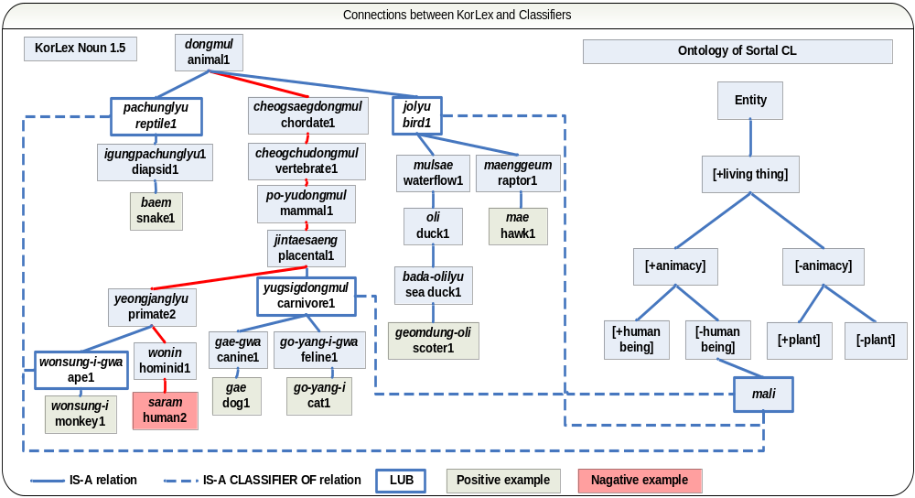
4.3 Generation of Relations between Nouns and Classifiers
Figure 2. Connection between Classifiers and Nouns in KorLex Noun 1.5

Slide 24
4.4 Results and Discussion
Table 3. Results of Korean Classifier Ontology
Relations | Size
IsHypernymOf | 1,350
IsHolonymOf | 258
IsSynonymOf | 142
QuantifyOf | 2,973
QuantifyClassOf | 287
Relations | Size
HasDomain | 696
HasOrigin | 657
HasStdIdx | 442
IsEquivalntToKL | 696
IsEquivalntToWN | 734

Slide 25
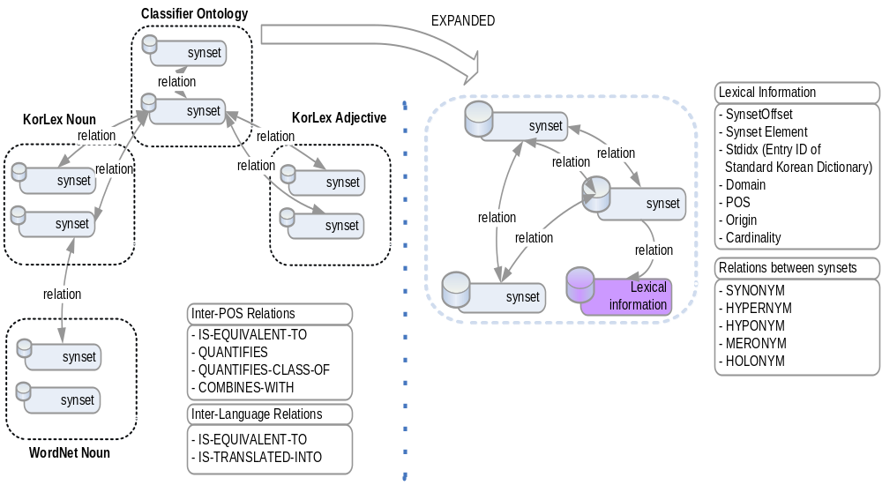
4.4 Results and Discussion
Figure 3. Overview of Korean Classifier Ontology
Notes:
Overview of Korean Classifier Ontology

Slide 26
4.4 Results and Discussion
1,138 Korean classifiers compose our classifier ontology
Currently, 508 classifiers has been added.
The size of the ontology is applicable to practical applications
Semantic relations (“Qunatifyof”, “QunatifyClassof”) between the classifier and nouns in KorLex are included.
Mensural and generic classifiers can quantify a wide range of noun classes
Sortal and event classifiers can combine with only a few specific noun classes

Slide 27
4.4 Results and Discussion
Table 4. Semantic classes of nouns quantified by Korean classifier
Types | Size | Classifiers | Nouns quantified by the classifier | Class of Nouns
Mensural | 772 | liteo (liter) | gogsig (grain 2), galu (powder 1), aegche (liquid 3) | substance 1
Sortal | 270 | mali (CL of counting animals except human beings) | nabi (butterfly 1), beol (bee 1) | invertebrate 1
 |  |  | gae (dog 1), go-yang-i (cat 1) | carnivore 1
 |  |  | geomdung-oli (scoter 1), mae (hawk1), | bird 1
 |  |  | baem (snake 1), badageobug (turtle 1) | reptile 1
Generic | 7 | jongryue (kind) | seolyu (paper 5), sinba l (footwear 2) | artifact1
 |  |  | jipye (paper money 1), menyu (menu 1) | communication2
Event | 89 | bal (CL of counting shots) | jiloe (land mine 1), so-itan (incendiary 2) | explosive device 1
 |  |  | gonggichong (air gun 1) | gun 1
 |  |  | chong-al (bullet 1), hampo (naval gun 1) | weaponry 1
 |  |  | lokes (rocket 1), misa-il (missile 1) | rocket 1

Slide 28
Table of Contents
Introduction
Related Work
Semantic Analysis of Korean Classifiers
Building Classifier Ontology
Conclusion and Further Work
Notes:
My presentation will be proceeded in the following order.
Before discussing the main issue of our study,
in section one, I’ll present general aspects of research, motivation and aims of study,
Section2 deals with related studies on the characteristics of classifiers, including Korean CLs, in more detail.
In section3, I’ll present the Knowledge Resources and NLP Techniques used in this work, and suggest a semantic classification of classifiers by integrating semantic properties and contextual features extracted from large corpora.
Section 4 shows how the hierarchies of classifiers are generated, and each classifier is connected to nouns or noun classes based on Korean linguistic knowledge and KorLex, then the constructed classifier ontology is evaluated.
Conclusions and future work follow in the final Section 5.

Slide 29
5. Conclusion and Further Work
Summary
Semantic categorization of Korean numeral classifiers, and the construction of classifier ontology by means of the semantic features of their related co-occurring nouns
The ontological relations of Korean numeral classifiers were semi-automatically extracted using NLP techniques
The results shows that the constructed ontology is sufficiently large and contains various relations to be applied to NLP subfields
    ‘IsEquivalentTo’ and ‘HasOrigin’ relations can be used to improve the performance in machine translation

Slide 30
5. Conclusion and Further Work
Further studies
Establishing refined classificatory standards for the classifiers
Applying Korean numeral classifier ontology to
    E-shopping or e-commerce
    Automatic translation of numeral classifiers
    E-Learning content for foreign learners of Korean

Slide 31
End of Talk
Thank you for your attention!
Any question or comments?

